Slide 1

Capstone project
Python Bootcamp Data Analysis for Beginners
Team-9: @Lena Fidrmuc
@Daniela Ullien
@Chinenye Okeke

Slide 2
Data
Life expectancy by WHO
Health indicators
BCG coverage by WHO:
Bacillus Calmette–Guérin(BCG) vaccine is a vaccine primarily used against TB
Covid-19 data by Worldometers

Slide 3
Questions
Do countries with higher life expectancy suffer more from Covid-19 in terms of deaths recorded?
Do countries where BCG vaccine was widely implemented have fewer infection rates per million?
Do countries where BCG vaccine was widely implemented have higher life expectancy?
What is the most Covid-19 affected continent in terms of infected cases and deaths?
What country has the highest ratio of recovered cases?

Slide 4
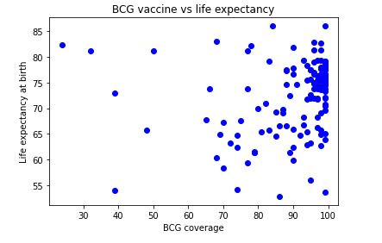
Do countries where BCG vaccine was widely implemented have higher life expectancy?

Slide 5
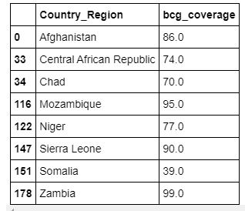
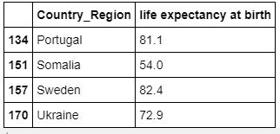
1. shows that even countries with high bcg coverage have lower life expectancy=<60 2. shows that even countries with lower bcg coverage=<40 have higher life expectancy

Slide 6
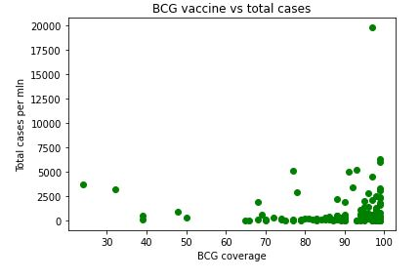
Do countries where BCG vaccine was widely implemented have fewer infection rates per million?

Slide 7
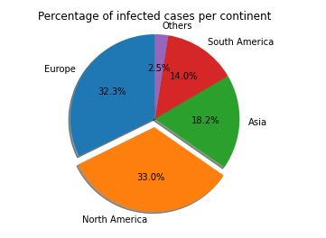
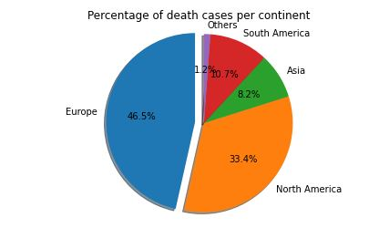
What is the most Covid-19 affected continent in terms of infected cases and deaths?

Slide 8
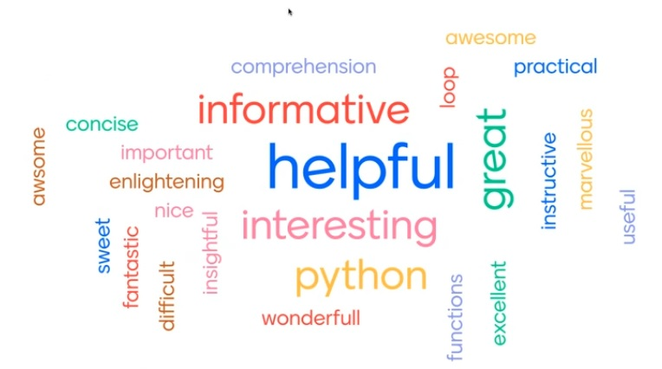
Thank you To Pyladies Amsterdam!

